Slide 1

Punctuality Drive
Group Members
Sadiq Ali
Rahul Yadav
Shivam Shukla
Suryansh Shukla
Tushar Sharma
Under Guidance Of
- Indu Verma

Slide 2
Introduction and Scope
This is punctuality drive where we decide which student is punctual or not, by marking their attendance at the time of entering in college and prepare a report of all punctual and late comers.
This application helps college to track student’s record

Slide 3
Purpose
The purpose of punctuality drive is to mark attendance of the student by face recognition and hence making a report of the defaulters (late comers) and those students who are punctual.
Main aim of this application is track the punctual students and try to make a noticeable shift in their habit, by giving them rewards and appreciations.

Slide 4
Language used
Front end
Python Tkinter GUI
Back end
My Sql
Python

Slide 5
Team members and their roles
Sadiq Ali :- Front end,Face Recognize module ,mark attendance and train data
Shivam Shukla :- Testing ,Documentation
Suryansh Shukla :-Front End and Backend Support
Rahul yadav:- Back end
Tushar Sharma :- Information Gathering

Slide 6
Project Modules
Student Detail
Insert student data consisting of [ Student ID, Name, Email ID, Branch, Year, Semester, Father’s Name, DOB, Gender, etc… ]
Data Capture
In data capture we capture student’s face and save with their respective details
Data Training
In data training we train data on the basis of given images details.
Face Recognition
In Face Recognition we recognize student’s face.
Mark Attendance
In this attendance is marked on the basis of recognized face.
Report Generation
In this we generate a report on the basis of student’s performance or punctuality.

Slide 7
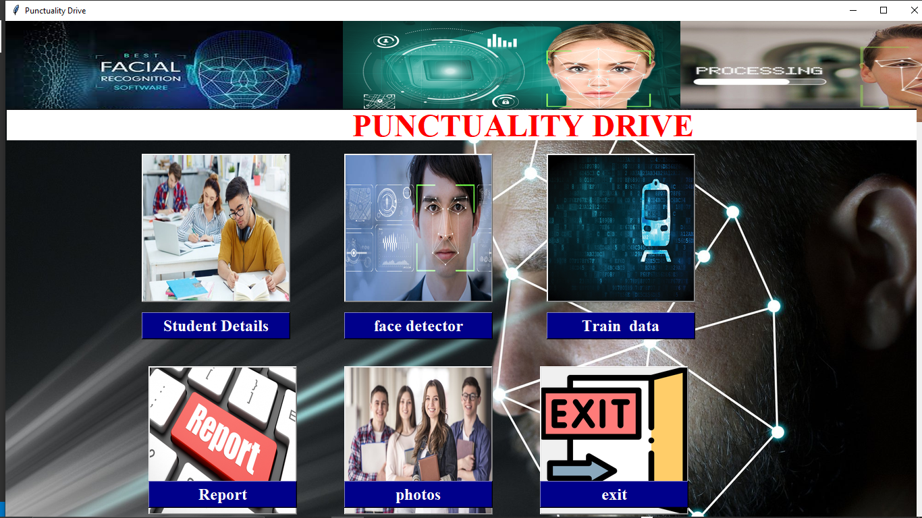
Snapshots Of Running Project
Home Page

Slide 8
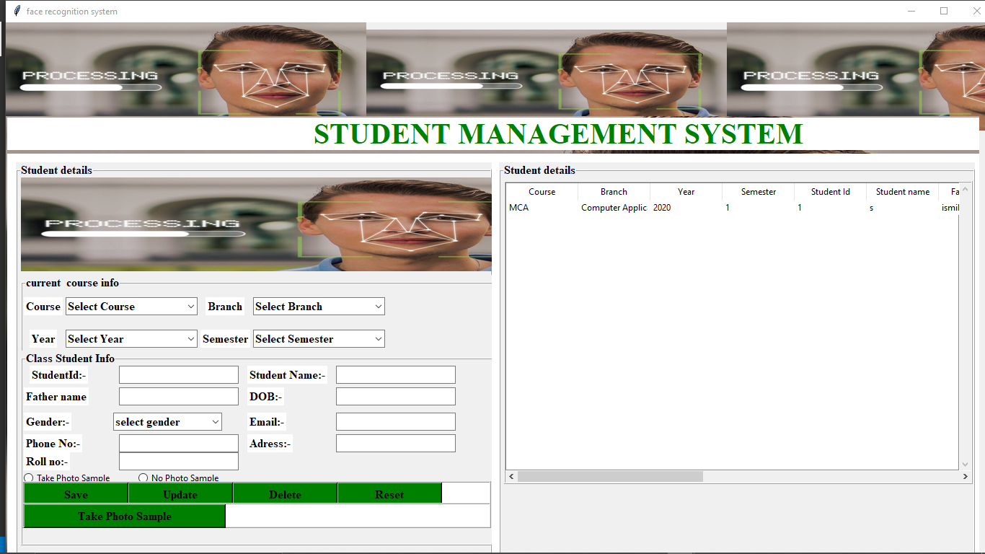
Student Details

Slide 9
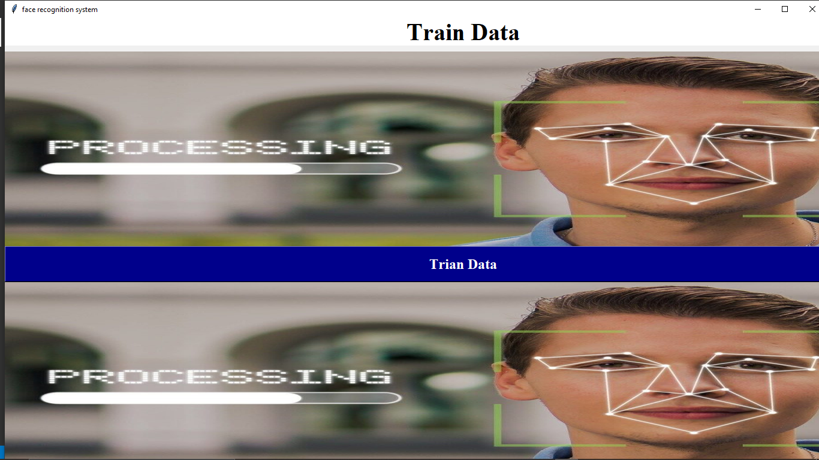
Training Data

Slide 10
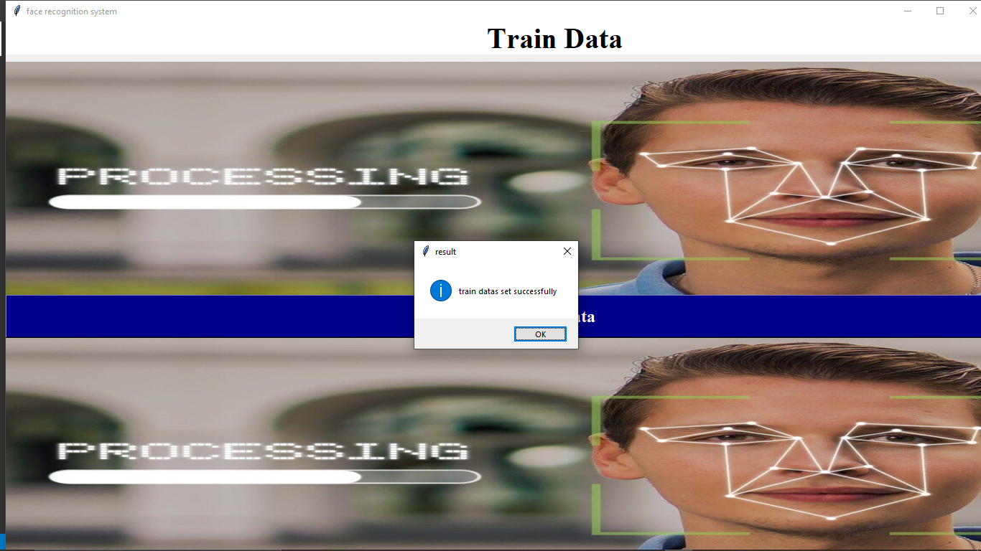
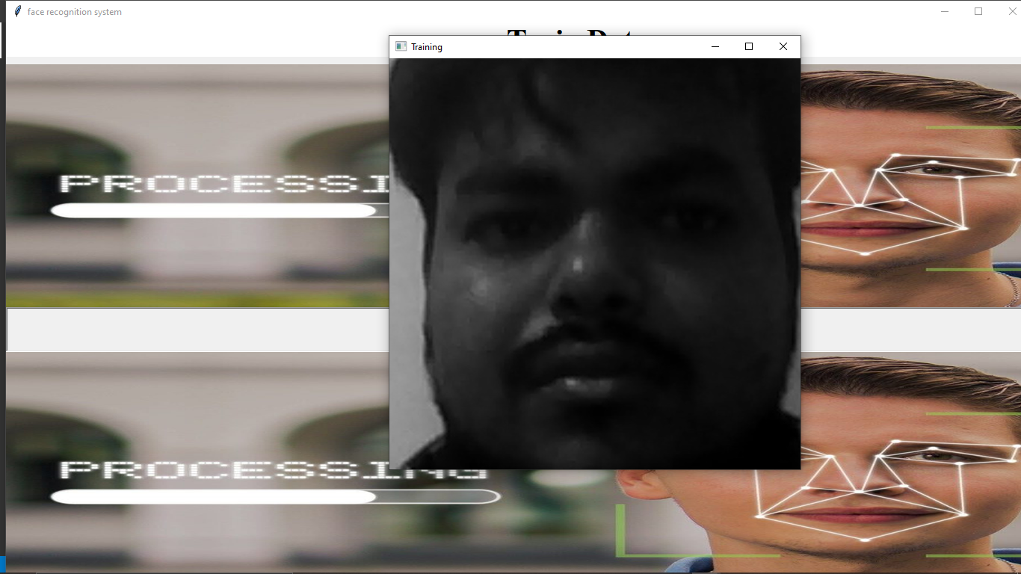
Training Data Set

Slide 11
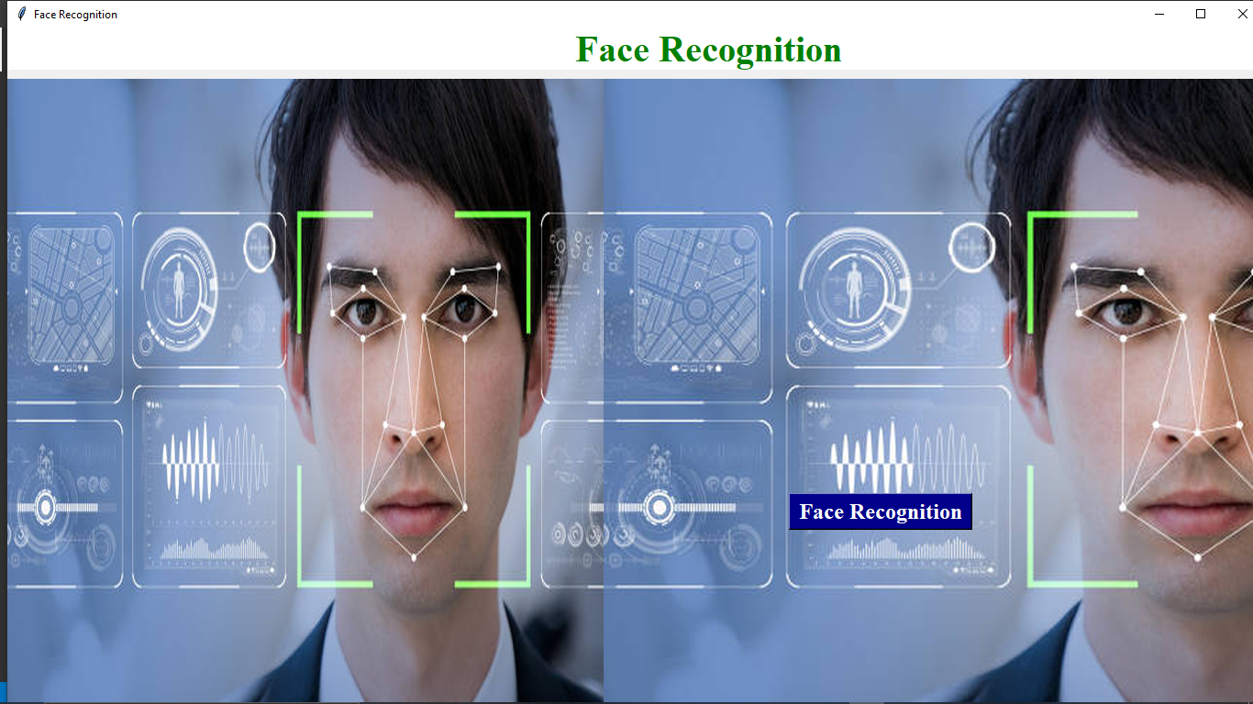
Face Recognition

Slide 12
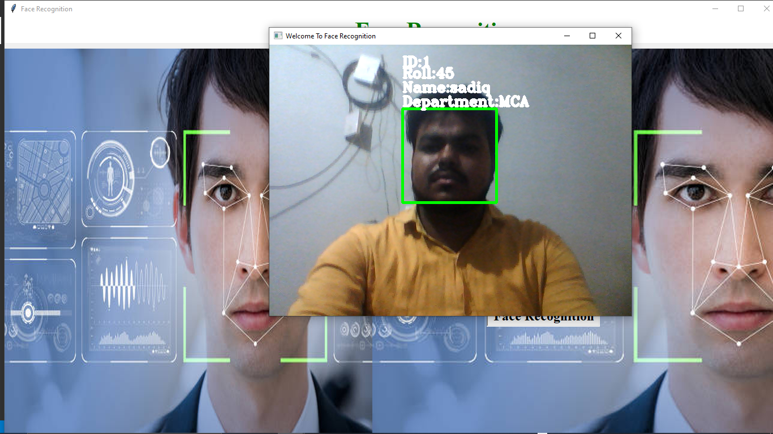
Face Recognize

Slide 13
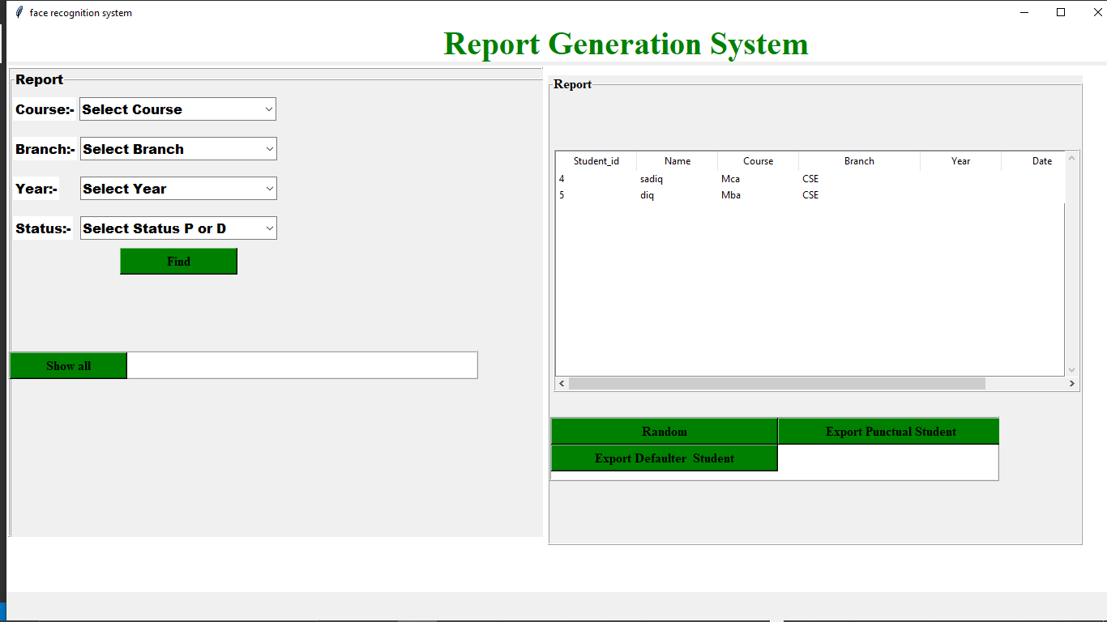
Report Generation (Pending)

Slide 14
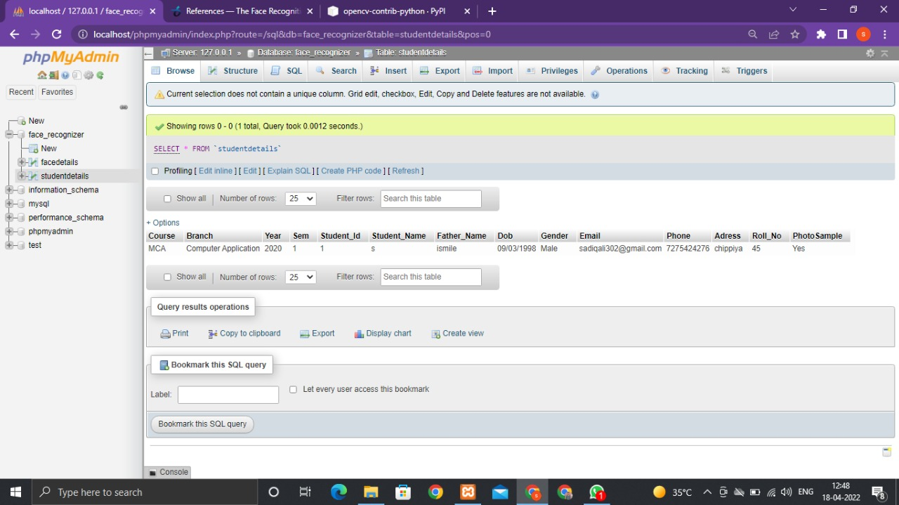
Database Student Details

Slide 15
Remaining Work
Mark Attendance
Connection on Report Generation
Random selection of Student for reward

Slide 16
Thank You

